Slide 1
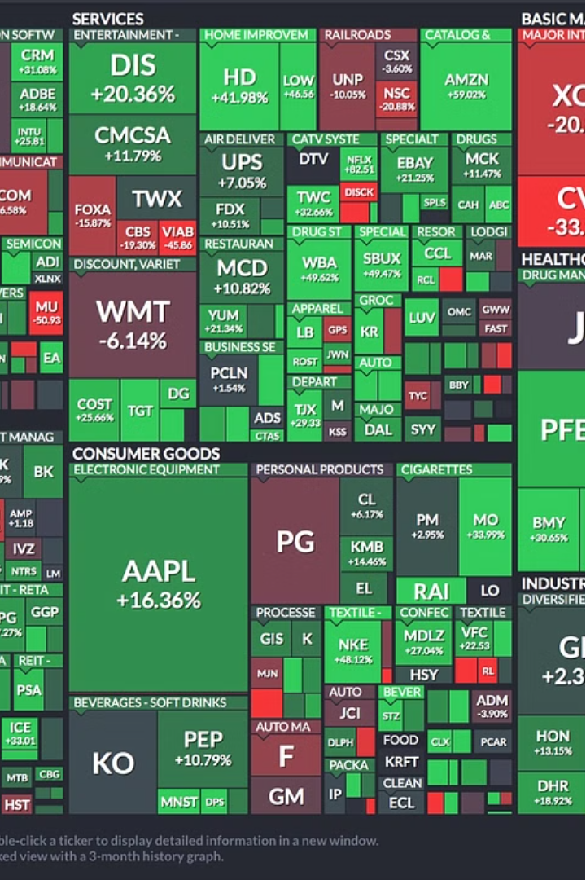
Machine Learning on Real-Time Data with Streaming Dataset
By –
Aman Rishal (22b3914),
Mehul Agrawal (210040091),
Rahul Meghwal (23v0055)

Slide 2

Abstract
The objective of this project is to develop a machine learning model that can predict stock market movements using streaming data. Traditional machine learning approaches often rely on static datasets, which may not adequately capture the dynamic nature of financial markets. Streaming data, on the other hand, offers a continuous flow of real-time information, allowing models to adapt and update themselves as new data becomes available.

Slide 3
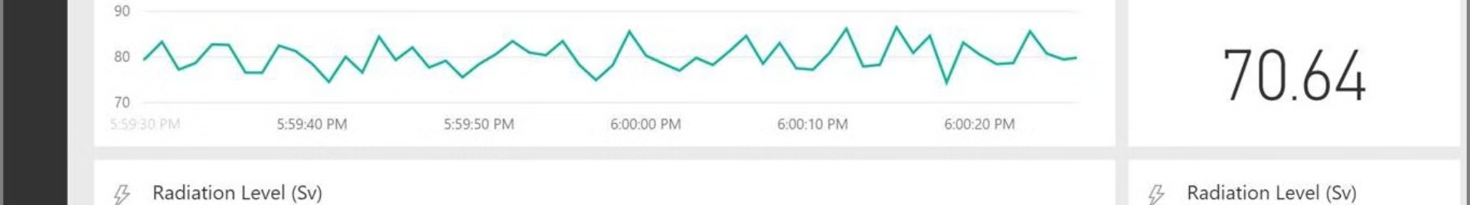
The Power of Streaming Data
Adaptability
Continuous Learning
Streaming data allows models to adapt and update themselves in real-time, capturing the dynamic nature of financial markets and staying ahead of evolving trends.
By continuously processing new data points, models can refine their understanding and improve their predictive capabilities over time, ensuring they remain effective in the long run.
1
2
3
Timeliness
With streaming data, models can make timely predictions, enabling investors and traders to make informed decisions and capitalize on market opportunities.

Slide 4
Overcoming Constraints
Computationally Non-heavy Model
Incremental Learning
Agile Adaptation
With streaming data, we do not have access to the entire dataset upfront. Instead, data arrives sequentially, and the model must adapt to new information as it becomes available. This constraint requires us to use online learning algorithms that can update themselves incrementally without needing to see the entire dataset at once.
The model must be able to quickly adapt to changes in the market, capturing the nuances of the stock market landscape as it evolves. This calls for a lightweight and flexible approach that can respond to new data in real-time.
Given the continuous nature of streaming data, it is essential to use algorithms that are computationally efficient and can update themselves in real-time. This rules out complex models that require heavy computational resources, such as deep neural networks.

Slide 5
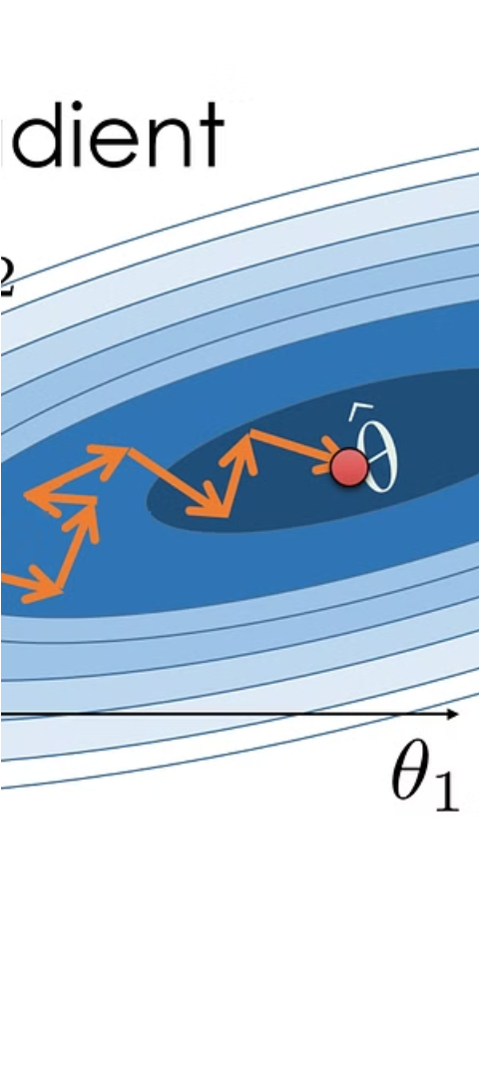
Our Approach: Stochastic Gradient Descent (SGD)
1
Preprocessing
2
Incremental Training
We preprocess the incoming data points to ensure their readiness for model training, including data cleaning, feature scaling, and feature engineering.
We employ incremental training methodologies, leveraging the lightweight Stochastic Gradient Descent (SGD), to train the model in real-time, allowing it to adapt and refine its parameters iteratively based on individual data points or small batches.
3
Continuous Learning
By training the model incrementally, we facilitate its continuous learning and improvement, ensuring that it remains agile and effective in capturing the nuances of the stock market landscape.

Slide 6
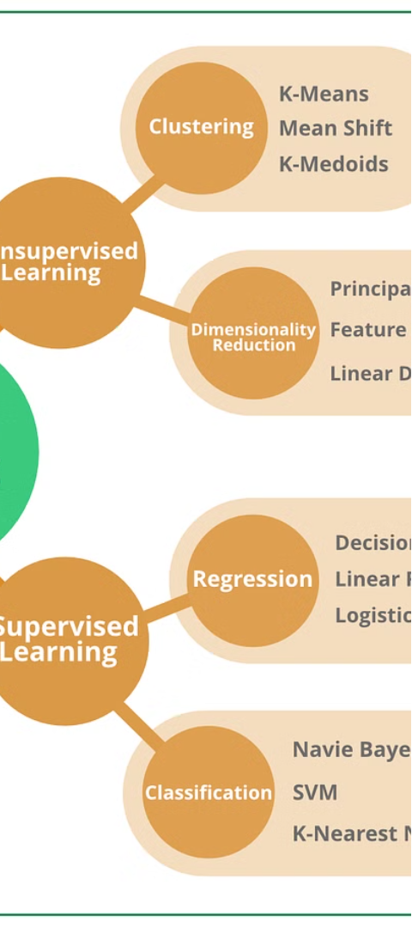
Algorithms in Action
Random Forest
Adaptive Boosting (AdaBoost)
Random Forest is an ensemble learning technique that builds multiple decision trees during training and outputs the mode of the classes (classification) or the mean prediction (regression) of the individual trees. It works well with streaming data by allowing the addition of new trees as new data becomes available, making it suitable for online learning scenarios.
AdaBoost is another ensemble learning algorithm that combines multiple weak learners to build a strong classifier. It can be adapted for regression tasks and has been used successfully in financial prediction tasks. It is computationally efficient and can adapt to changes in the data distribution over time, making it suitable for handling streaming data in stock market prediction scenarios.
Stochastic Gradient Descent (SGD)
Stochastic Gradient Descent (SGD) is a simple yet efficient optimization algorithm that updates the model parameters using individual data points or small batches. It is suitable for scenarios where data arrives sequentially, such as streaming datasets, and allows the model to adapt to new data in real-time and converge to an optimal solution over time.

Slide 7
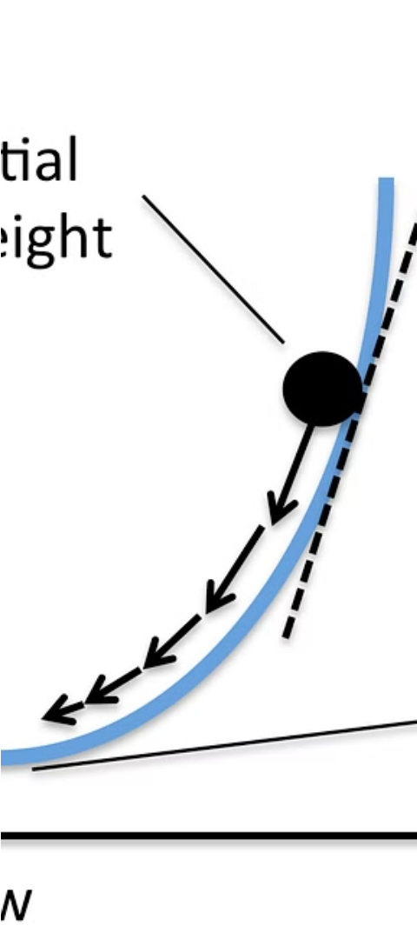



Stochastic Gradient Descent (SGD) in Depth
Data Preprocessing
The incoming data points undergo preprocessing, including parsing temporal features and normalizing numerical features, to ensure their suitability for model training.
Iterative Training
The model undergoes continuous refinement, with the SGD algorithm updating the parameters iteratively based on individual data points or small batches, allowing the model to adapt to new information in real-time.
Evaluation
Performance metrics, such as mean squared error (MSE), are monitored during training to provide insights into the model's convergence and generalization ability.

Slide 8



SGD with Block: Enhancing Efficiency
Block-based Updates
Streaming Data Processing
Improved Performance
Unlike traditional SGD, which updates the model parameters using individual data points or small batches, SGD with Block updates the model parameters using larger blocks of data, improving computational efficiency.
The block-based approach can lead to better performance compared to traditional SGD, as processing larger blocks of data at once can enhance the model's ability to capture patterns and trends in the streaming data.
We implement SGD with Block by iterating over the streaming dataset, converting each example into a DataFrame, and processing the data in blocks when the block size is reached.

Slide 9
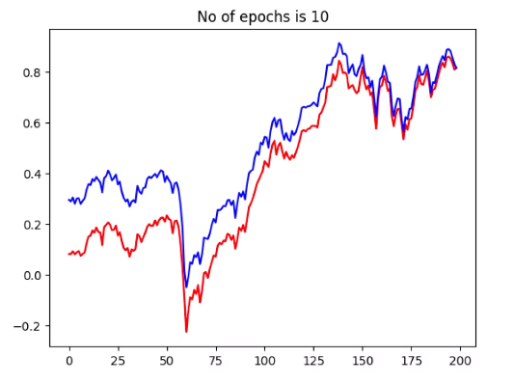
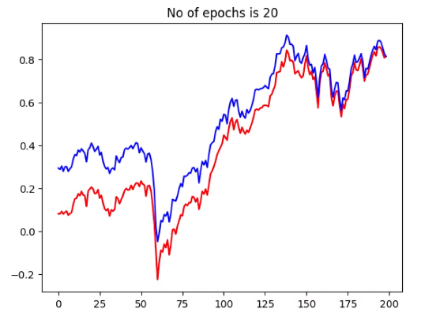
Results - Without Block
20% of the data was set aside for testing. We obtained an MSE of 0.08 on
this test dataset. A visual representation of the differences between actual and
predicted values is shown below for different numbers of epochs.
Figure 1: Actual vs. Predicted Values (10 Epochs)
Figure 2: Actual vs. Predicted Values (20 Epochs)

Slide 10
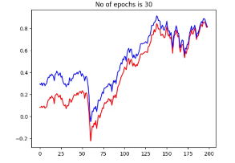
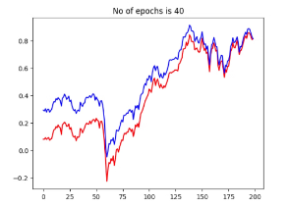
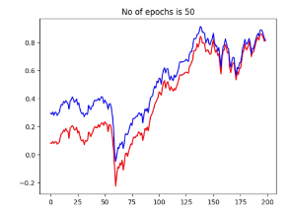
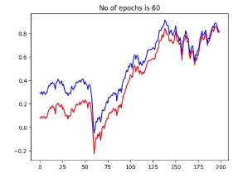
Results -Without Block
Figure -3 (30 Epochs)
Figure -4 (40 Epochs)
Figure -5 (50 Epochs)
Figure -6 (60 Epochs)

Slide 11
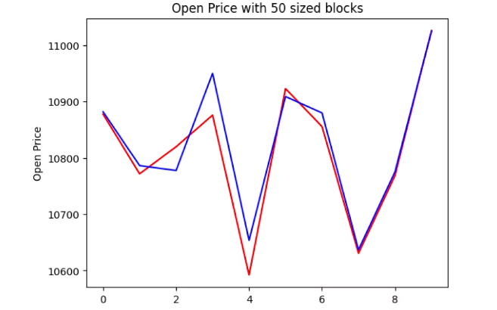
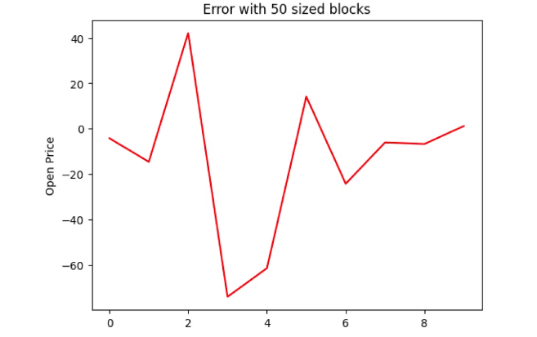
Results - With Block
Figure 8: Actual vs. Predicted Open Prices after processing 1 block
Figure 9: Error in predicted Open Prices after processing 1 block

Slide 12
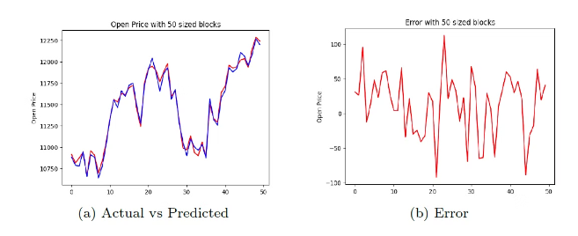
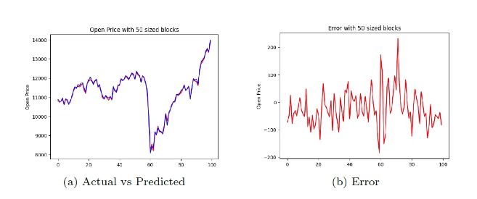
Results - With Block
Figure 10: Opening price after 5 blocks
Figure 11: Opening price after 10 blocks

Slide 13
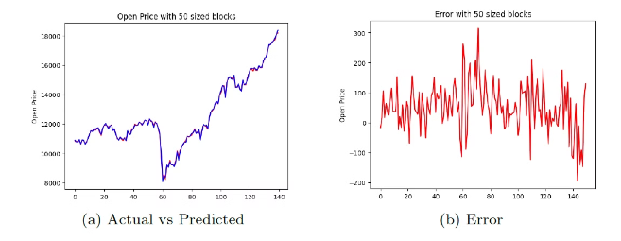
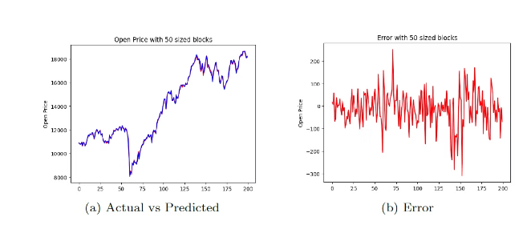
Results - With Block
Figure 12: Opening price after 15 blocks
Figure 13: Opening price after 20 blocks

Slide 14
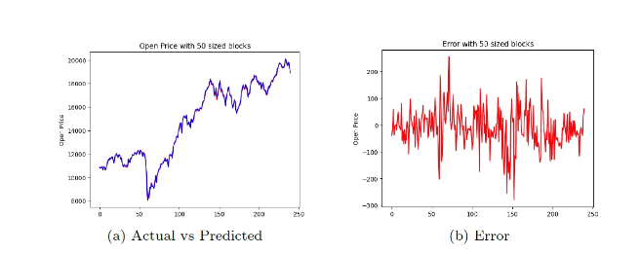
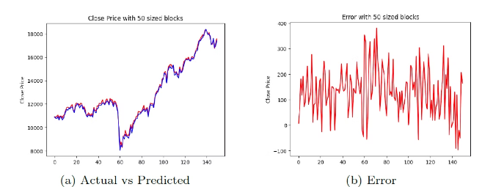
Results - With Block
Figure 14: Opening price after 24 blocks
Figure 15: Closing price after 5 blocks

Slide 15
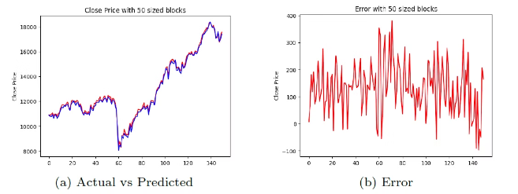
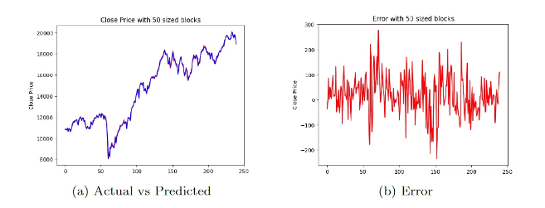
Results - With Block
Figure 16: Closing price after 15 blocks
Figure 17: Closing price after 24 blocks

Slide 16

Conclusion
In conclusion, the application of Stochastic Gradient Descent (SGD) to real-time data with streaming datasets has proven to be a powerful approach. By overcoming the constraints of traditional batch-based learning, our solution enables agile adaptation to evolving market conditions.

